Slide 1


Mash monoliths into manageable modules
With Mediatr
Alex Brown
@alexJamesBrown
github.com/alexJamesBrown

Slide 2
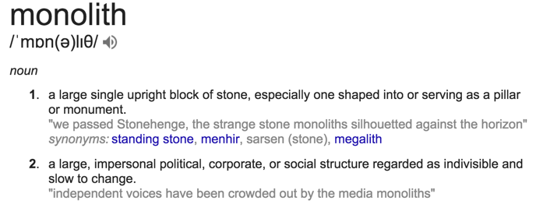
What is a monolith

Slide 3
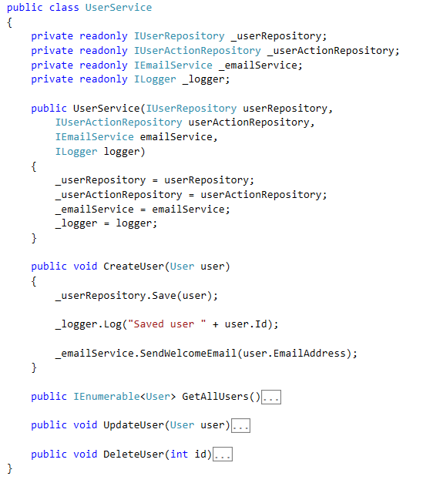
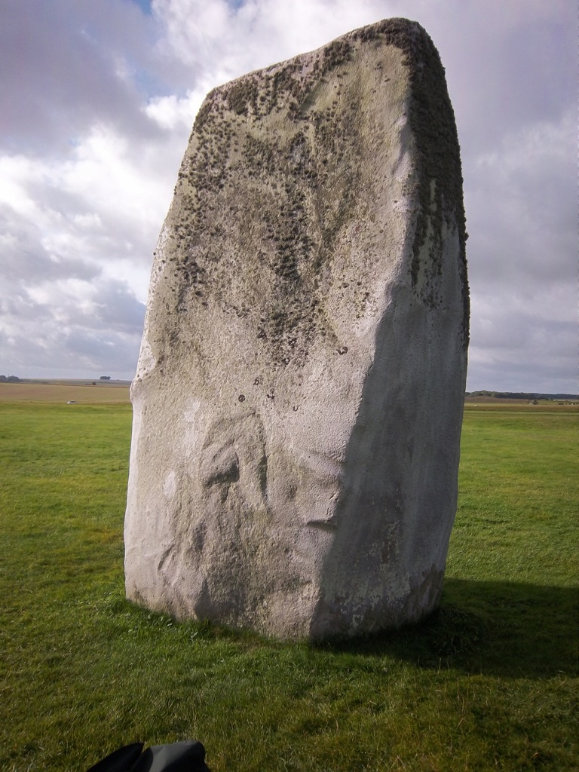
What is a monolith
Notes:
Dddd
Dfdf
dfdfdf

Slide 4
Monoliths through layers
User Interface
Business Logic / Application Layer
Data Layer
Database(s)
Notes:
Can also apply to the structure of code

Slide 5
Monoliths through layers
Business Logic / Application Layer
Data Layer
Notes:
Two layers I want to focus on
BAL - BUsiness layer, application layer. Called all manner of things
DAL, Data access, etc…

Slide 6
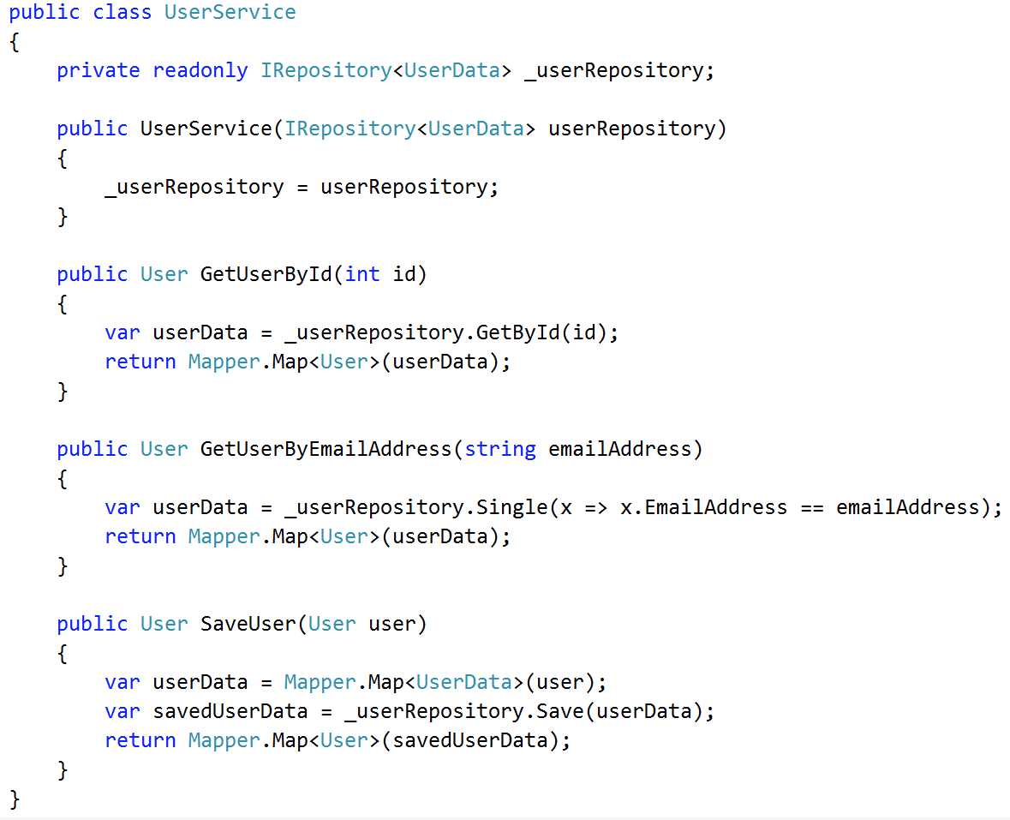
Layer ‘pass through’
Business Logic / Application Layer
Data Layer

Slide 7
Layer ‘pass through’
User.cs
UserController.cs
UserService.cs
UserRepository.cs
Business Logic / Application Layer
Data Layer

Slide 8
Layer ‘pass through’
UserService.cs
GetUserById(int id);
GetUserByEmailAddress(string emailAddress);
SaveUser(User user);
DeleteUser(User user);
GetAllUsers();
UserExists(string emailAddress);
….

Slide 9
Testing monoliths is no fun...

Slide 10
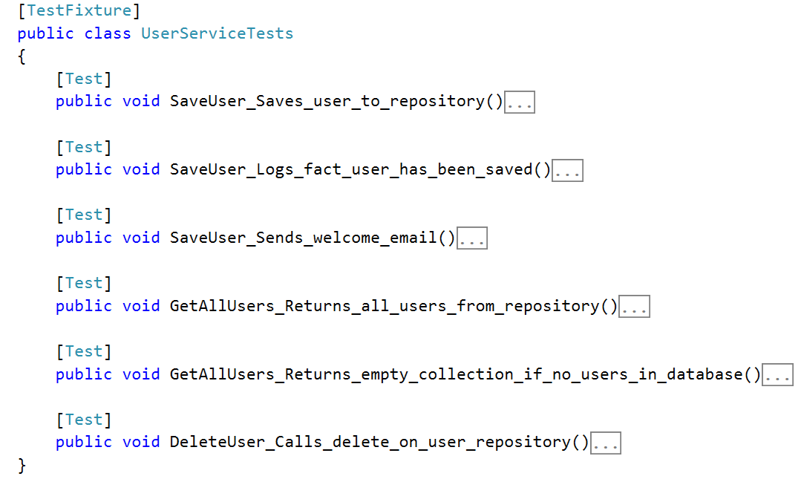
Notes:
Many lines…
Seen > 2000 in some cases

Slide 11
Merge Hell...

Slide 12
Enter CQS Command Query Separation
Coined by Bertrand Meyer, author of Object-Oriented Software Construction
Every method should either be:
a command that performs an action
a query that returns data to the caller
- but not both
Progression from traditional service / repository layered structure.
Allows large code bases to become more SOLID.
Emphasis on the S

Slide 13
Mediator Pattern
Provides a mediator class which is used to handle communication between related objects
Objects do not need to know about each other
Colleague
Colleague
Colleague
Mediator
Colleague
Colleague
Colleague

Slide 14
Mediator Pattern - Commands / Queries & Handlers
Command Handler
Command Handler
Query Handler
Query
Query
Mediator
Command
Command
Command Handler
Query Handler
Query Handler

Slide 15

Mediatr
By Jimmy Bogard
Notes:
Started in 2004

Slide 16
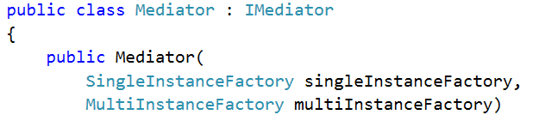
Dependency Free
No external dependencies (since version 2)
Previous versions had dependency on CommonServiceLocator
Constructor takes 2 delegates:

Slide 17
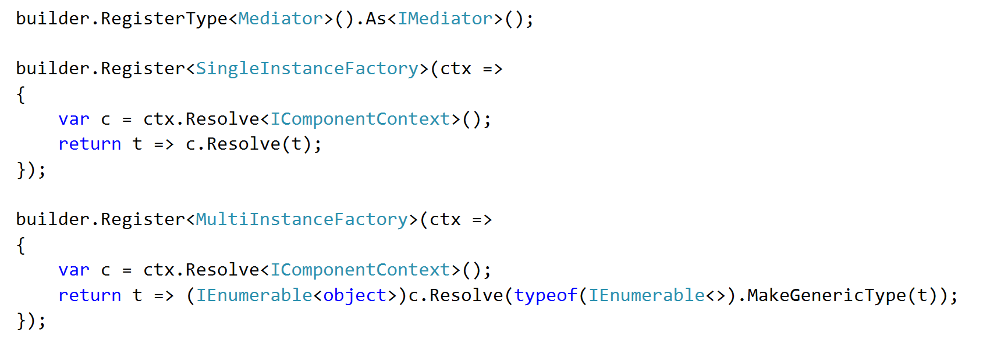
Setting up Mediatr - Autofac

Slide 18
Commands
Queries
Handlers

Slide 19
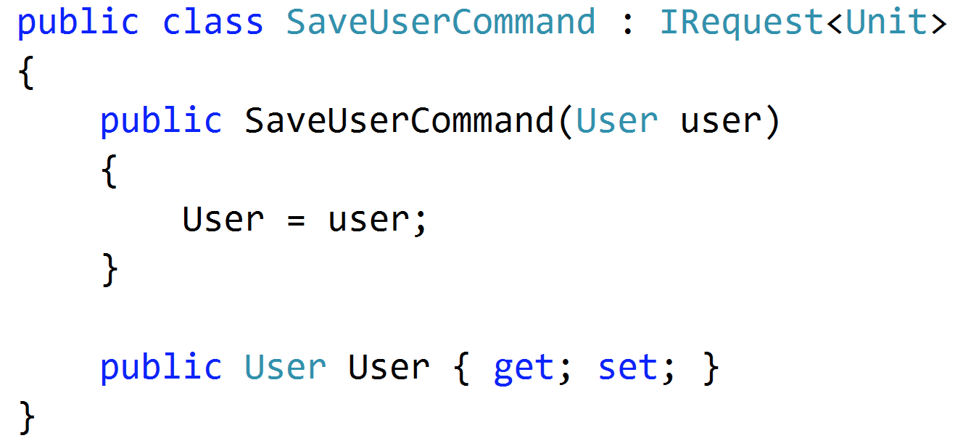
Command

Slide 20
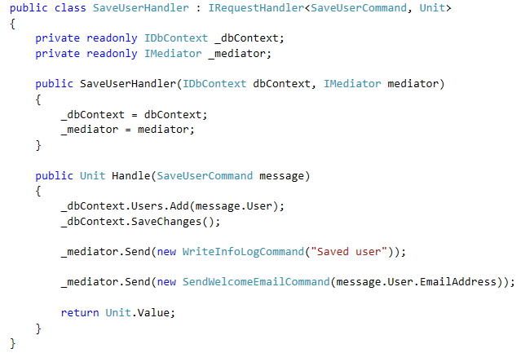
Handler

Slide 21
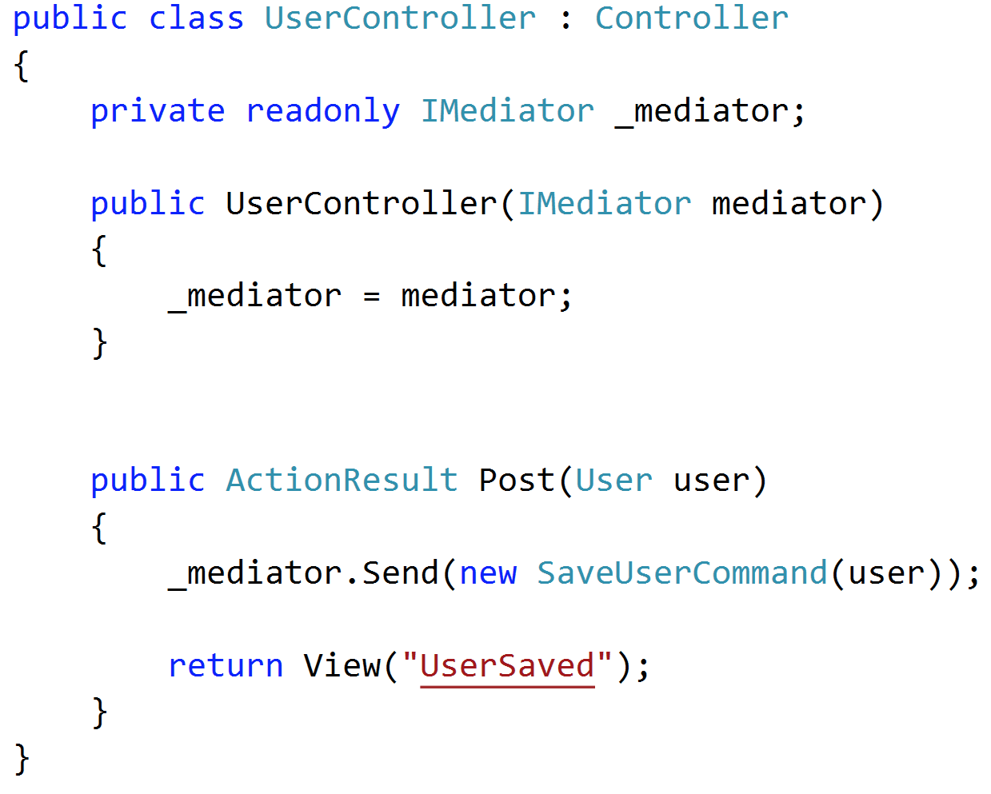
Consuming the Mediatr

Slide 22
Vertical slices instead of layers
User Interface
Business Logic / Application Layer
Get All Users
Get User By Email Address
Save User
Data Layer
Database(s)
Notes:
Can also apply to the structure of code

Slide 23
Breaking down existing monolithic classes

Slide 24
Breaking down a monolith
CreateUserCommand
CreateUserCommandHandler
GetAllUsersQuery GetAllUsersQueryHandler
UpdateUserCommand
UpdateUserCommandHandler
DeleteUserCommand
DeleteUserCommandHandler

Slide 25
Demo...

Slide 26
Cleaner, readable tests
Notes:
Only testing one method
Much easier to test

Slide 27
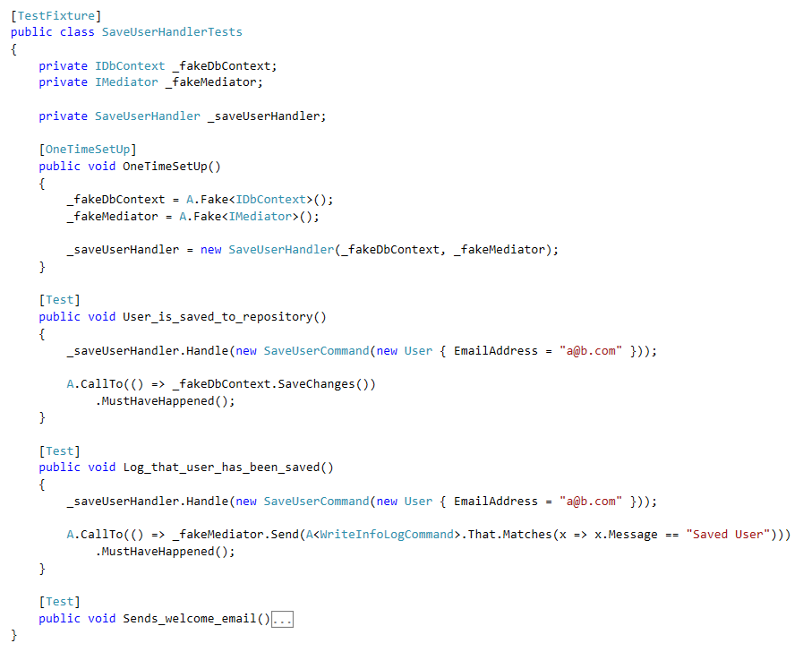

Slide 28
Mash monoliths into manageable modules
With Mediatr
Alex Brown
@alexJamesBrown
github.com/alexJamesBrown

